Slide 1
Lecture 33: Universal Turing Machine
Agenda:
Universal Turing Machine
Encoding with UTM
Presented by
Prof. Vaibhav Narayan Chunekar
K. J. Somaiya College of Engineering, Vidyavihar, Mumbai
KJSCE

Slide 2
A Universal Turing Machine
KJSCE

Slide 3
A limitation of Turing Machines:
Turing Machines are “hardwired”
they execute
only one program
Real Computers are re-programmable
KJSCE

Slide 4
Solution: Universal Turing Machine
In computer science, a universal Turing machine (UTM) is a Turing machine that simulates an arbitrary Turing machine on arbitrary input. The universal machine essentially achieves this by reading both the description of the machine to be simulated as well as the input to that machine from its own tape
KJSCE

Slide 5
History Behind UTM
Alan Turing introduced the idea of such a machine in 1936–1937. This principle is considered to be the origin of the idea of a stored-program computer used by John von Neumann in 1946 for the "Electronic Computing Instrument" that now bears von Neumann's name: the von Neumann architecture.
KJSCE

Slide 6
Compare UTM with Multi Tape TM
In terms of computational complexity, a multi-tape universal Turing machine need only be slower by logarithmic factor compared to the machines it simulates
KJSCE

Slide 7
Solution:
Univesal Turing Machine
Attributes:
Reprogrammable machine
Simulates any other Turing Machine
KJSCE

Slide 8

Universal Turing Machine
simulates any Turing Machine
Input of Universal Turing Machine:
Description of transitions of
Input string of
KJSCE

Slide 9
Tape 1
Three tapes
Description of
Universal
Turing
Machine
Tape 2
Tape Contents of
Tape 3
State of
KJSCE

Slide 10
Tape 1
Description of
We describe Turing machine
as a string of symbols:
We encode as a string of symbols
KJSCE

Slide 11








Alphabet Encoding
Symbols:
Encoding:
KJSCE

Slide 12






State Encoding
States:
Encoding:
Head Move Encoding
Move:
Encoding:
KJSCE

Slide 13
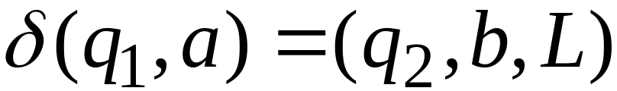
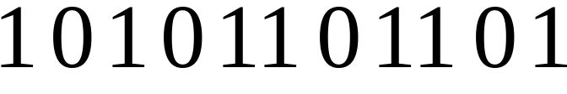
Transition Encoding
Transition:
Encoding:
separator
KJSCE

Slide 14
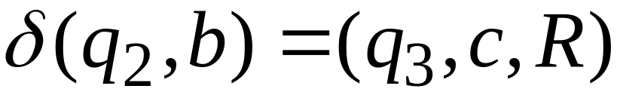

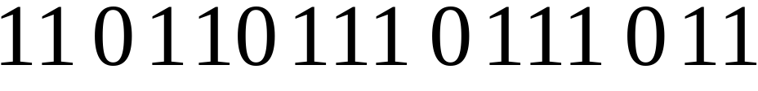
Turing Machine Encoding
Transitions:
Encoding:
separator
KJSCE

Slide 15
Tape 1 contents of Universal Turing Machine:
binary encoding
of the simulated machine
Tape 1
KJSCE

Slide 16
A Turing Machine is described
with a binary string of 0’s and 1’s
Therefore:
The set of Turing machines
forms a language:
each string of this language is
the binary encoding of a Turing Machine
KJSCE

Slide 17
Language of Turing Machines
L = { 010100101,
00100100101111,
111010011110010101,
…… }
(Turing Machine 1)
(Turing Machine 2)
……
KJSCE

